Slide 1

Miya
Alexa
Yurick
Hristiyan

Slide 2

First, a story…

Slide 3


THE STORY OF JOHN

Slide 4


Slide 5
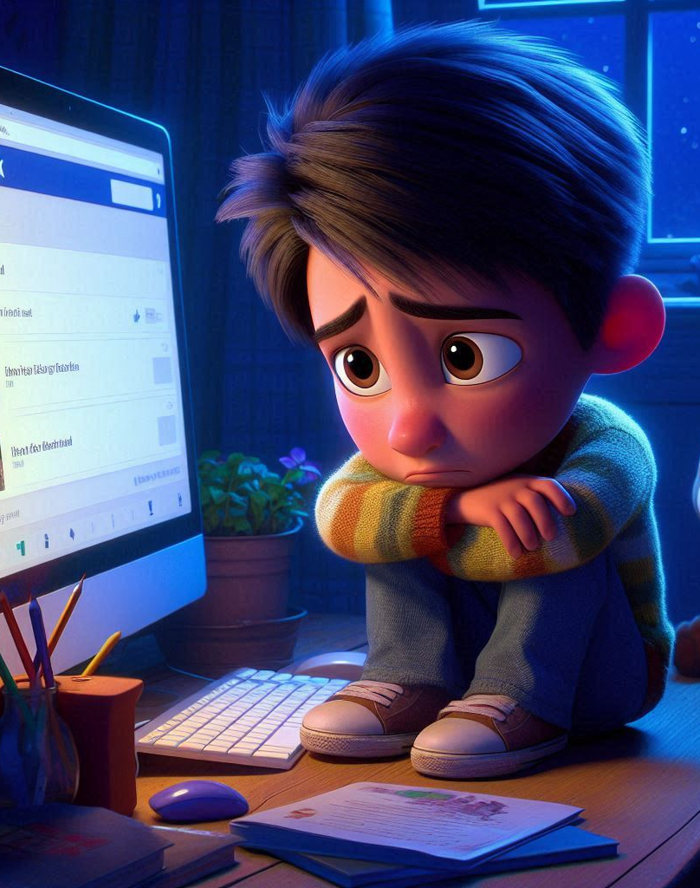

Slide 6
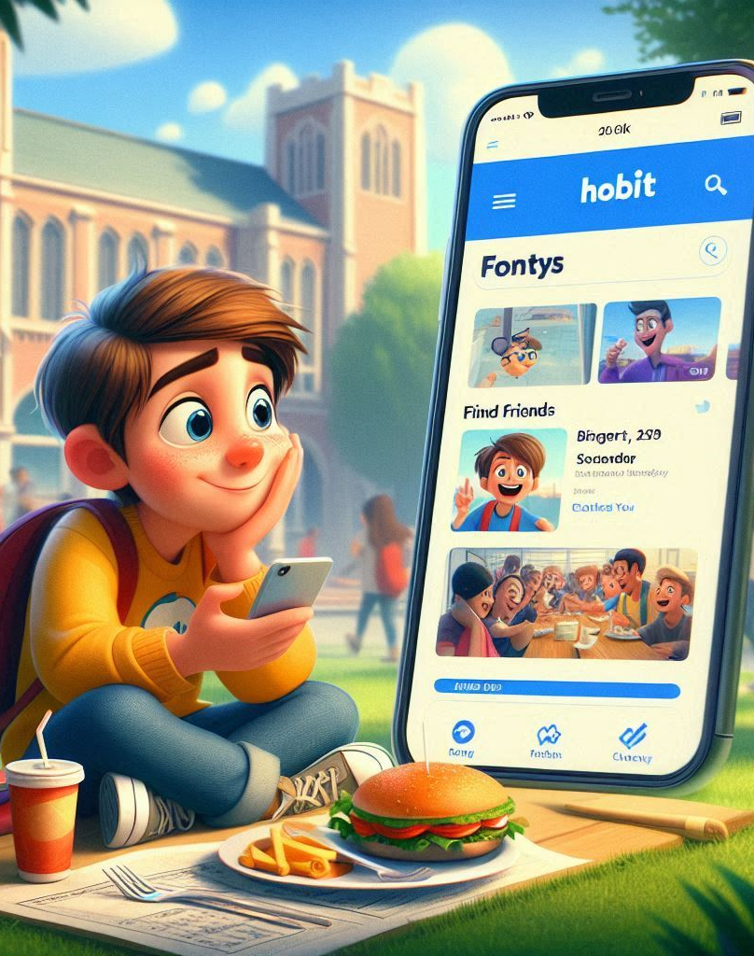

Slide 7


Slide 8
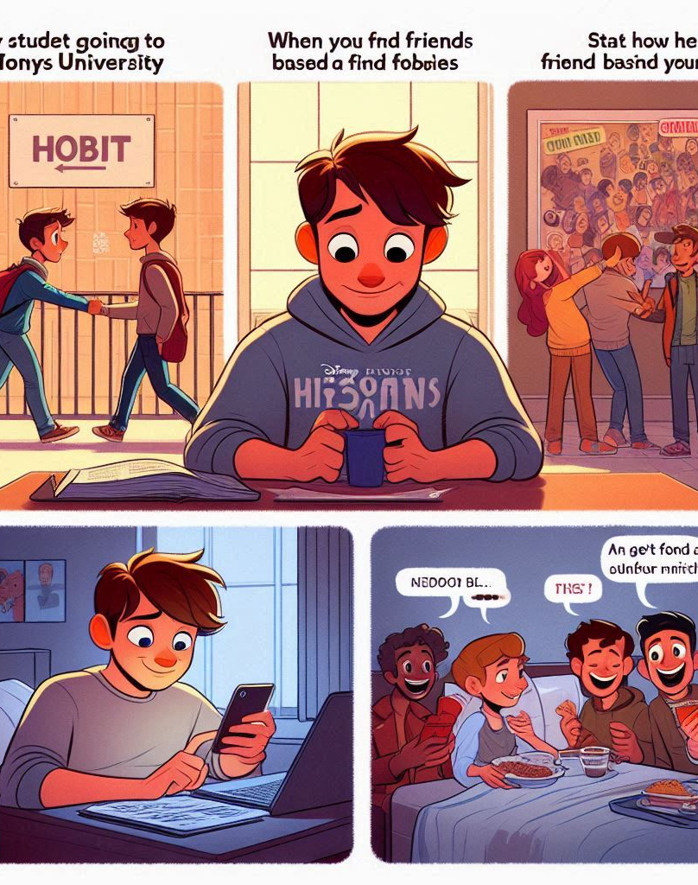
THE END

Slide 9



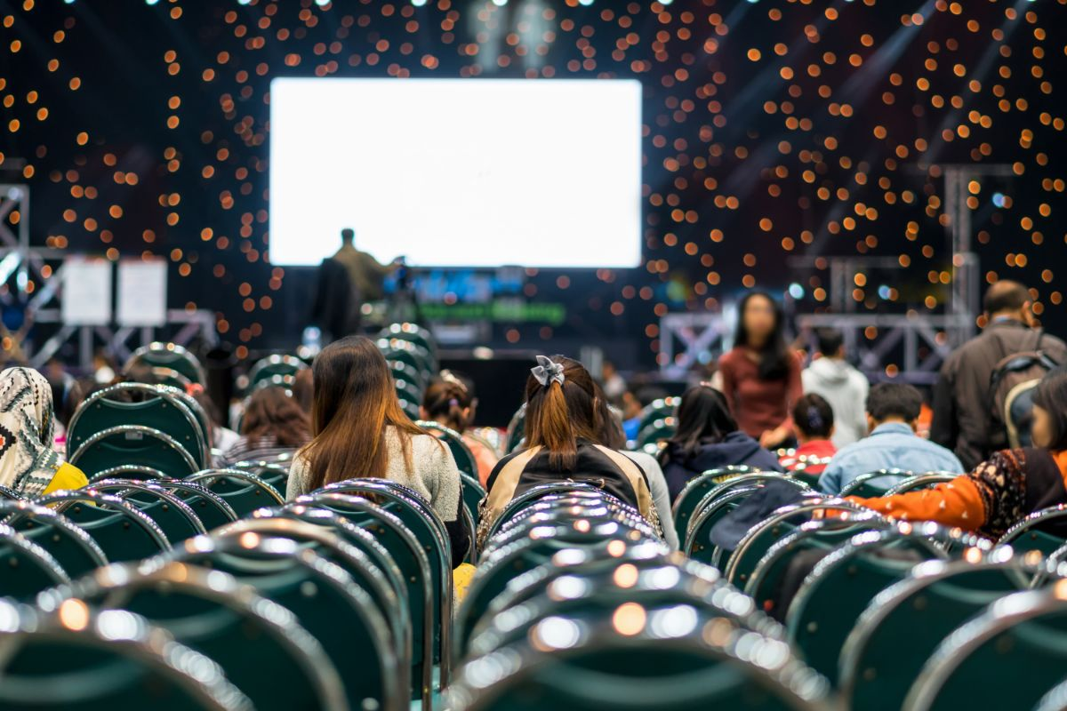
PROBLEM
Notes:
Tinder

Slide 10
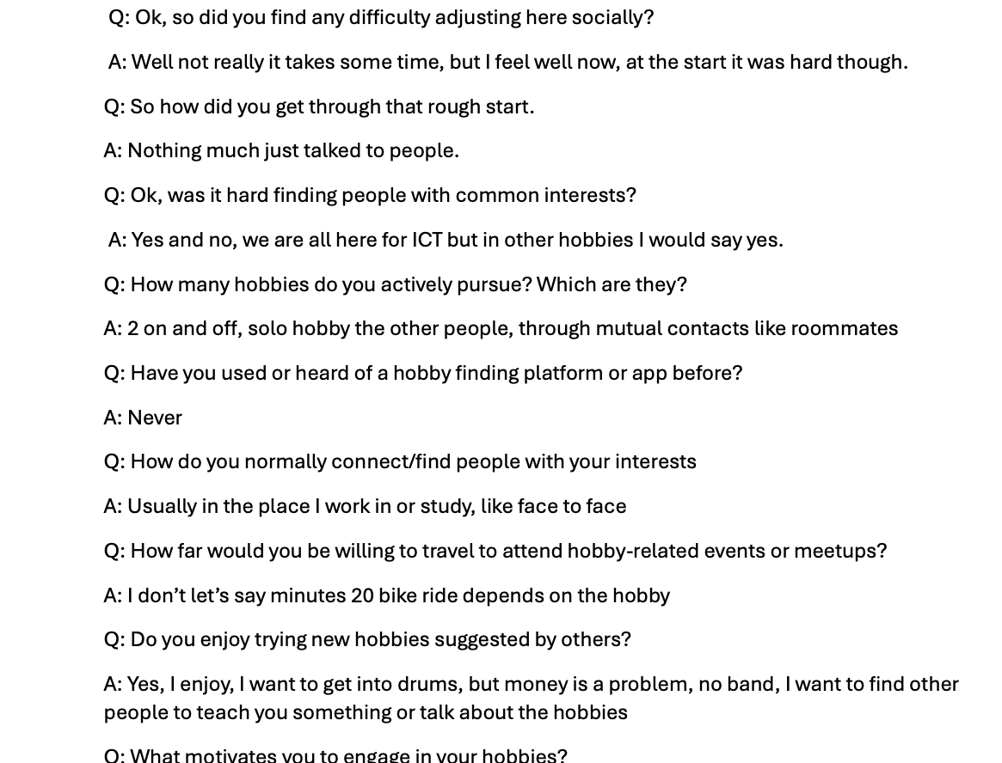
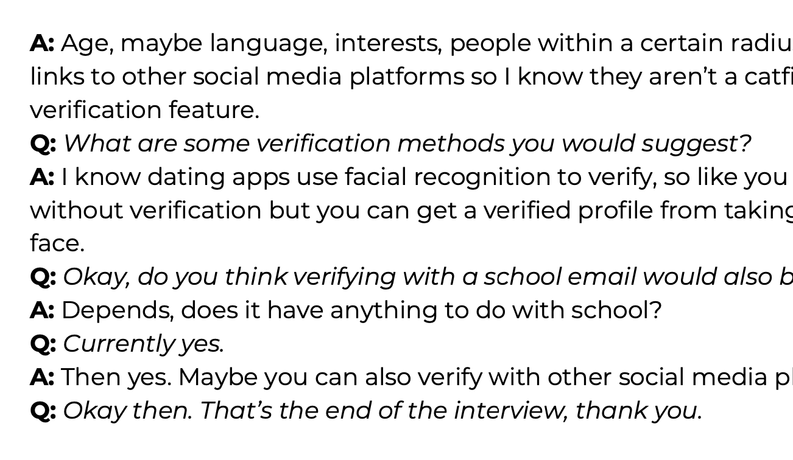
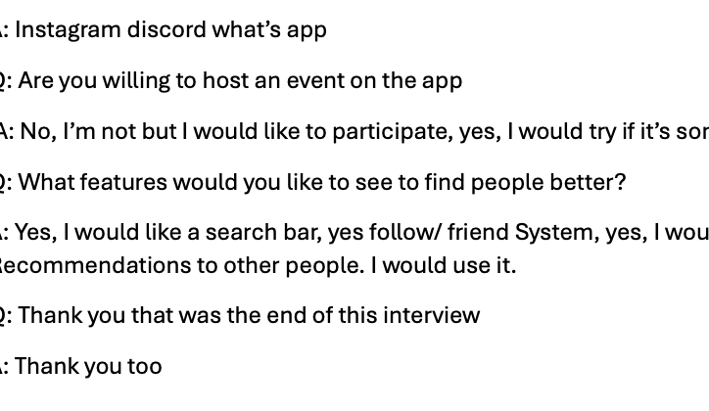
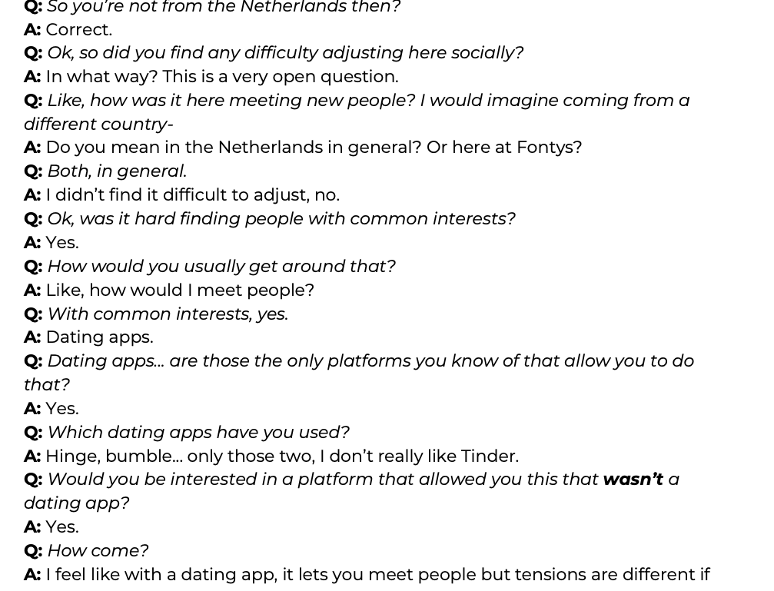

Slide 11
PROBLEM

Slide 12
SOLUTION

Slide 13
OUR SOLUTION
Notes:
Our solution contains 4 main features

Slide 14
COMMON HOBBIES
SOLUTION

Slide 15
SECURITY
SOLUTION

Slide 16
SOCIAL PLATFORMS
SOLUTION
Notes:
It’s a portal to the other social medias

Slide 17
EVENTS
SOLUTION
Notes:
With our website you can create and attend events based on your hobbies

Slide 18
IT’S TIME FOR
DEMO

Slide 19

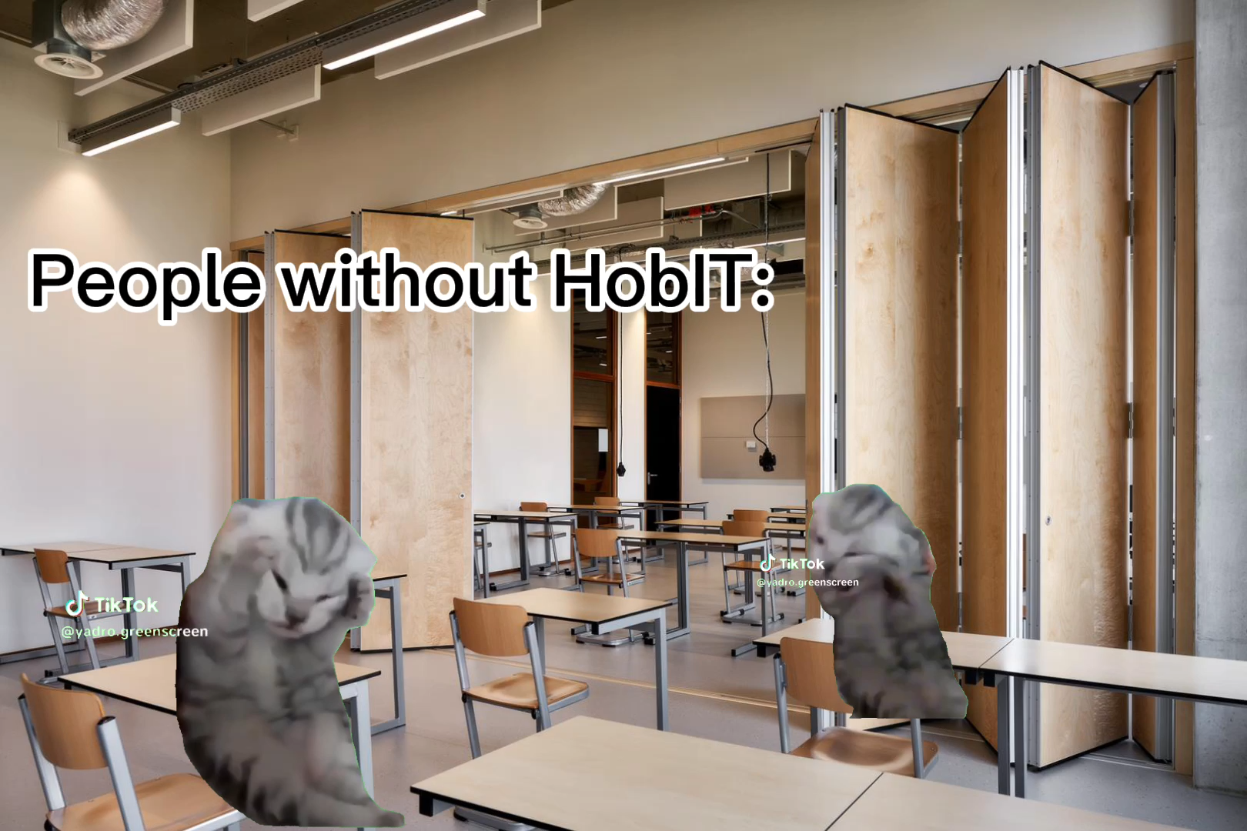




Slide 20
REFLECTION
Notes:
r

Slide 21
THANK YOU FOR THE ATTENTION!
Questions?

